Slide 1
Guidance for writing conference abstracts
Erin Godecke, Elizabeth Lynch, Dominique Cadilhac

Slide 2
Webinar Overview
Acknowledgement of country
13:30 | Introduction Welcome to Country Overview | Erin Godecke
13:35 | Abstract Guidelines 2024 - Overview | Elizabeth Lynch
13:40 | Abstract Scoring Matrix | Elizabeth Lynch
13:50 | Creating your abstract Structure and interpreting results Handy hints and tips | Dominique Cadilhac Erin Godecke
14:20 | Questions and Discussion | All
14:30 | Close

Slide 3
Abstract guidelines
Title
Introduction
Methods
Results
Conclusion
Relevance to clinical practice or patient experience

Slide 4
Abstract guidelines
Title
Introduction
Methods
Results
Conclusion
Relevance to clinical practice or patient experience

Slide 5
Abstract guidelines
Title
Capitalise the First Letter of all Major Words in the Title
Common to present research question or findings plus methods
Evaluating the National Stroke Audit Program. A Mixed Methods Study
Socioeconomic Status is Associated with Health-Related Quality of Life After Stroke—An Australian State-wide Record Linkage Study
“Well, I May as Well Go Home Because I Felt No One Was Listening to Me”: Yarning with People Living with Stroke About Their Recovery Experience. A Qualitative Study

Slide 6
Abstract guidelines
Title
Introduction
Methods
Results
Conclusion
Relevance to clinical practice or patient experience

Slide 7
Abstract guidelines
Title
Introduction
Set the scene
Present what is known, what is unknown – brief and concise
Should only be one or two sentences
Present research question/s or research aim / hypothesis
AVOID lots of acronyms

Slide 8
Abstract guidelines
Title
Introduction
Methods
Results
Conclusion
Relevance to clinical practice or patient experience

Slide 9
Abstract guidelines
Methods
Important part of your abstract for marking
How did you recruit your participants? (if relevant)
How did you collect your data?
How did you analyse your data?
Describe your approach to analysis of the data

Slide 10
Abstract guidelines
Title
Introduction
Methods
Results
Conclusion
Relevance to clinical practice or patient experience

Slide 11
Abstract guidelines
Results
Make sure this relates to your research question and your methods
Be as specific as you can
AVOID “Results will be presented…”
How many people recruited?
Brief description of participants (age, sex, stroke details/profession)
Key results – present statistical analysis (e.g. odds ratios or p values) when appropriate

Slide 12
Abstract guidelines
Title
Introduction
Methods
Results
Conclusion
Relevance to clinical practice or patient experience

Slide 13
Abstract guidelines
Conclusion
Key findings of your research that answer your research question/s
Relevance to clinical practice or patient experience
Why do your research findings matter?
What impact will it have/ how does the study add to existing evidence?
*Important for abstract marking

Slide 14
Abstract scoring matrix ( /10)
Scientific quality (4 points)
Randomised controlled trials | /4
Large systematic reviews | /4
Observational studies adjusted for confounders | /3
High quality qualitative studies | /3
Quality improvement studies – collect data before and after, clear aim, clear QI methodology with clear rationale | /2
High quality audits | /2
Observational studies | /2
Good quality qualitative studies | /2
Well-presented case reports describing unusual presentations | /1
Case reports that are not novel, abstracts without clear methodology | 0

Slide 15
Abstract scoring matrix ( /10)
Novelty, originality of project and data (2 points)
Has this been done before?
Is this interesting?
Potential impact on clinical practice or patient experience (3 points)
How useful is this to clinicians, people with stroke, researchers?
Why does this research matter?

Slide 16
Abstract scoring matrix ( /10)
Quality of writing (1 point)
Don’t overstate findings
Conclusion addresses aim
Avoid typos, use abstract template
Other
Must provide data in results section
“Data will be provided” will not be considered for oral presentation

Slide 17
Creating your abstract - Dominique
Partner with collaborators with academic and clinical experience to help improve your writing and research skills
All feedback and perspectives are valuable
Sometimes we don’t see what others do!
Avoid technical language and jargon
An iterative process is best: first two or three responsible authors then send to other co-authors
Usually first, second and last (senior author)
Need to allow sufficient time before the abstract due date
Three examples of the abstract drafting process and the editorial process will be outlined

Slide 18
DRAFT ABSTRACT 1 [initial draft V1]
Title: Delivery of stroke care in hospitals participating in the Australian Stroke Clinical Registry
Background Guidelines and performance indicators have been established for acute stroke care (National Stroke Foundation, 2010). The Australian Stroke Clinical registry (AuSCR) provides a mechanism for monitoring adherence to guidelines and can assist hospitals to identify processes of care with scope for improved performance.
Aims To use the data from the 2011 AuSCR Annual Report to determine the level of evidence-based acute stroke care in participating Australian hospitals.
Methods The AuSCR captured detailed demographic and clinical data on patients with stroke and transient ischaemic attack. Data were analysed for individual sites as well as overall levels.
Results 2519 patients (with 2593 episodes) from sixteen hospitals were registered during 2011. The mean age of the patients was 73 years, 47% were female and 72% were Australian-born. Care was provided on a stroke unit for 77% (range across sites: 0-100%) of patients and 79% (range: 67-88%) received antihypertensive therapy. Among patients with ischemic stroke, 14% (range: 0-18%) received thrombolysis. 33% of discharged patients received a care plan. The median length of stay for patients in a stroke unit was 7 days compared with 5 days on other wards (p< 0.001), with the former having 1.9 fold increased odds of discharge to a rehabilitation facility (95% CI: 1.4 to 2.5).
Conclusion Patients admitted to hospitals participating in the AuSCR received high-quality stroke care based on a number of performance measures, but there were marked variations in the interventions between sites and ward types. Future research should explore explanations for these findings and focus on solutions to implementing more widespread evidence based practice.

Slide 19
Focus of these edits was to reduce words and give more detail in the results.

Slide 20
ABSTRACT 2 [unedited V1]
Title: Counsellor education program for stroke
Background: In order to improve counselling services for stroke survivors and carers the NSF established an interdisciplinary Advisory group to develop a Counsellor Education Program. This group created training materials as well as a DVD about depression following stroke.
Aim: a) To measure the effectiveness and appropriateness of the program in the pilot phase; b) To assess retention of counsellors’ knowledge on stroke facts.
Methods: Data were collected from counsellors prior to and after training session; stroke survivors and carers attending counselling and people who received the DVD.
Results: 33 counsellors attended training session (76% female; 82% aged 45-64 years, 75% health professionals; 60% were based in Tasmania). 33% reported having had no personal experience of stroke. Since training session, counsellors improved their knowledge of facts about stroke: Proportion of people experience depression after stroke (Pre 30%, Follow-up 60%, p=0.04); Stroke kills more women than breast cancer (Pre 48%, Follow-up 84%, p=0.003). Only two eligible consumers provided feedback on their counselling experience. Of those who received the DVD 79% had taken action since watching the DVD.
Conclusions: The Counsellor Education Program appears to be an acceptable and effective method for training counsellors about stroke and its relationship to depression and other conditions.

Slide 21
Abstract section | Content | Reason for edits
Title | Establishment of a counsellor education program for stroke: a National Stroke Foundation (NSF) initiative | Important to highlight organisation or group responsible for the program evaluated
Background | To improve counselling services provided to stroke survivors and carers in the community the NSF established an interdisciplinary Advisory group to develop a Counsellor Education Training Program. A formal evaluation of the pilot program was undertaken. The program was developed in partnership with beyondblue; Relationships Australia (New South Wales and Tasmania) and the National Stroke Research Institute. | Important to highlight background and purpose/rational as well as who was involved in design of program
Aims: | To measure the appropriateness of the program; and to assess program effectiveness by measuring retention of counsellors’ knowledge on stroke facts | Simplifying the text so easier to read/ clearer)
Methods | Pre-post evaluation design. Quantitative and qualitative data were collected from counsellors using questionnaires prior to and immediately after the single (six-hour) training session, and 3 months after the training. Where subcategory data were missing it was assumed the response was negative. | Important to give detail on what was actually done. How data were collected and when and how data were analysed? Reviewer can then judge quality of research methods and analysis
Results | 33 counsellors attended training (76% female; 82% aged 45-64 years, 75% health professionals; 60% based in Tasmania); 56% reported having no personal experience of stroke; 36% had previously worked with stroke survivors and 15% had prior training in stroke. Most counsellors ‘strongly agreed’ or ‘agreed’ that the program was well organised (91%); well paced (91%) and that the group activities helped their learning (84%). Following training, counsellors improved their knowledge about stroke, such as being able to correctly report on the proportion of people that experience depression after stroke (Pre 30%, Follow-up 60%, p=0.04) and stroke kills more women than breast cancer (Pre 48%, Follow-up 84%, p=0.003). | Results are always of the most interest so better to have less background and more information here)
Conclusions | The Counsellor Education Program was appropriate and effective for training community-based counsellors about stroke and its relationship to depression | Important to keep punchy and match back to original aim/s

Slide 22
Why reworking and carefully proofing your abstract matters –
it will be published and live forever of the www!
https://journals.sagepub.com/doi/abs/10.1177/1747493019858233?journalCode=wsoa

Slide 23
ABSTRACT 3 [unedited V1] Words 250 (currently 369)
Background
Changing clinical practice is complex. The Shared Team Efforts Leading to Adherence Results (STELAR) program was designed as a multifaceted intervention directed at clinicians to improve stroke care. A stepped-wedge cluster randomised controlled trial of the program has been undertaken in Victorian hospitals.
Aims
To describe how the STEALAR intervention was delivered and received by clinicians at participating hospitals.
Methods
The intervention included: 1) a pre-survey of clinicians, 2) two externally facilitated workshops: where local clinical performance data from the Australian Stroke Clinical Registry were reviewed and there was development of an action plan to improve practice, and 3) support (email or phone) provided by the external facilitator for two months. The process evaluation included data collected via direct observations of workshops, a participant satisfaction survey, facilitator log for details of support offered, and semi-structured interviews with clinical champions and the external facilitator at completion of the intervention. Qualitative data were analysed thematically, and quantitative data summarised descriptively.
Results
Eight hospitals completed the pre-survey prior to workshop 1, 18 workshops were completed at nine hospitals involving 144 clinicians. All hospitals developed action plans, with seven selecting multiple processes of care to focus on (2-4). Response rate for the satisfaction survey was 62%. Having the project driven and facilitated by an external organisation, and a team with recognized expertise in stroke was useful, and use of AuSCR data was an important motivator for change. Being involved promoted engagement of the wider multidisciplinary team, and greater collaboration. The external facilitator was described as knowledgeable, and particularly assisted in guiding the development of the action plan and strategies. However, respondents described that limited buy-in and engagement of medical staff influenced clinical change, and often the area of focus. Turnover of staff and unexpected absences of local clinical champions at hospitals also impacted on potential change. It was perceived that having a longer support period would be beneficial, as many strategies were still being implemented after the intervention finished.
Conclusion
Results of this process evaluation provide important context relating to the primary results and permit reproducibility.

Slide 24
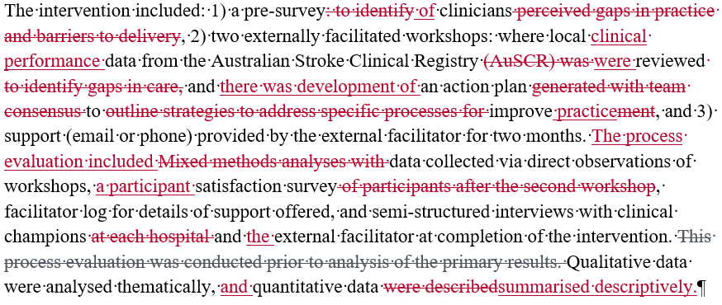
Abstract section | Content | Reason for edits
Title | Reducing clinical variation in Victorian hospitals: process evaluation of the Shared Team Efforts Leading to Adherence Results (STELAR) project
Background |  | Number hospitals mentioned in results so have taken out here
Aims: |  | Check carefully for spelling mistakes. Avoid unnecessary use of acronyms
Methods

Slide 25
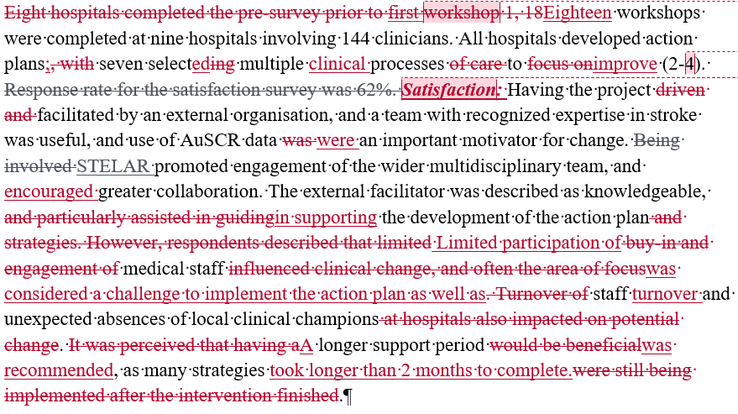
Abstract section | Content | Reason for edits
Results |  | Not presenting data on this so wasting words What are these numbers referencing to IQR, min-max? Is this the right subheading or did you triangulate from all sources? Other edits to simply sentences and reduce words
Conclusions |  | reduce words (Overall 294 at this point!)

Slide 26
Abstract section | Content | Reason for edits
Aims: |  | Co-author helped to simplify and reduce words (something the first 2 authors didn’t see!)
Methods |  | Can you say what the pre-survey was? Delivery of care, organisational context…

Slide 27
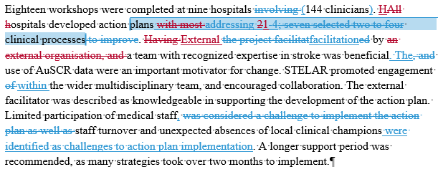
Abstract section | Content | Reason for edits
Results |  | Not sure if this is correct. If 7 had 2-4 what happened with the other 2? (check your numbers make sense)
Conclusions |  | (252 words at this point!)

Slide 28
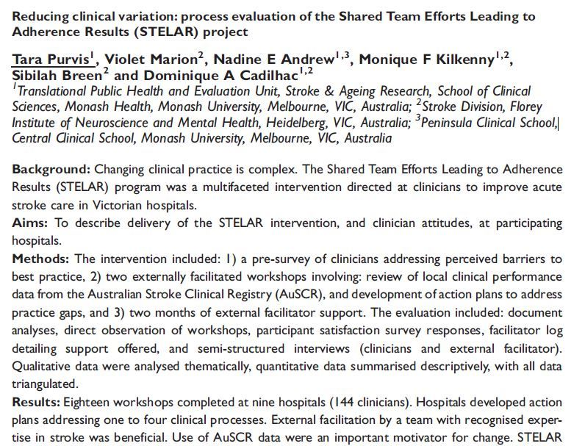
Final published version

Slide 29
Questions and Discussion

Slide 30
Hints and Tips
Start early – this takes longer than you think!
Seek help from a mentor or someone who has done this before
Only very common acronyms, and use acronyms sparingly
The word ‘data’ is plural so should be written: “The data are/were…”
Make sure your numbers add up in the results section
Get someone (who hasn’t read it before) to proofread before submission

Slide 31
Some other resources
https://blog.wordvice.com/preparing-a-medical-research-abstract-for-publication/
https://medical-school.uq.edu.au/files/21875/How-to-write-an-abstract.pdf
https://services.unimelb.edu.au/__data/assets/pdf_file/0007/471274/Writing_an_Abstract_Update_051112.pdf
https://cures.cardiff.ac.uk/files/2014/10/NSAMR-Abstract.pdf

